Slide 1

An Introduction to my Text Mining Project on Zhu Fan Zhi诸藩志
Jiating Liu

Slide 2

Contents
Part 1: What sources / objects I am working with?
Part 2: What I have done?
What I have learned in the process?
Part 3: What are my next steps?

Slide 3
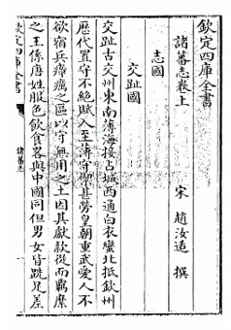
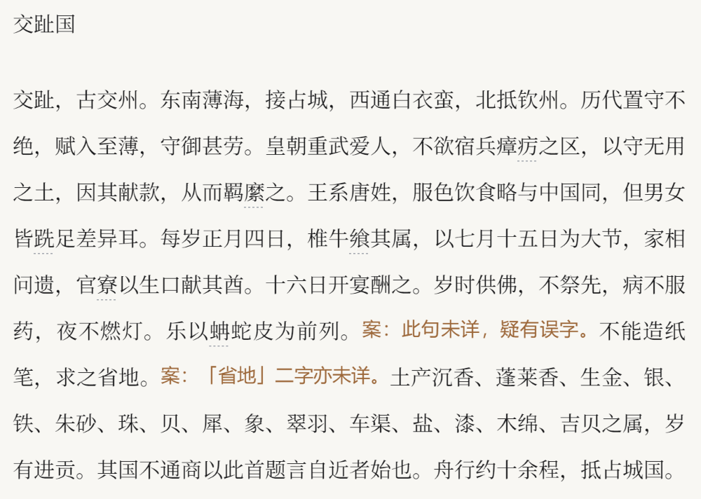
Part1: What is my source? Why did I choose it?
Part1: What sources / objects I am working with?
Zhu Fan Zhi (Records of Foreign Nations)- Song Dynasty (960-1279 CE)
Author: Zhao Rukuo

Slide 4
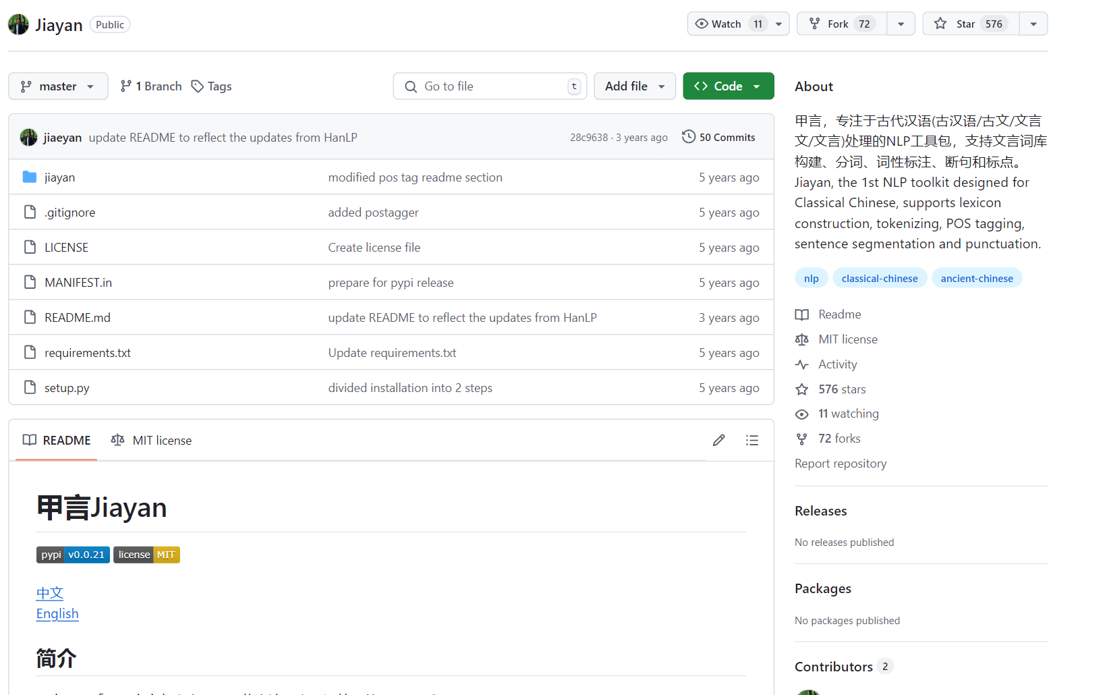
Part2: What I have done and learned?
Part1: What is my source? Why did I choose it?
Topic Analysis (LDA)
High-Frequency Word
Word Segmentation
Word Filtering
Stop-word List
Zhufanzhi Special Dictionary
Jiayan NLP toolkit甲言
https://github.com/jiaeyan/Jiayan?tab=readme-ov-file#2

Slide 5
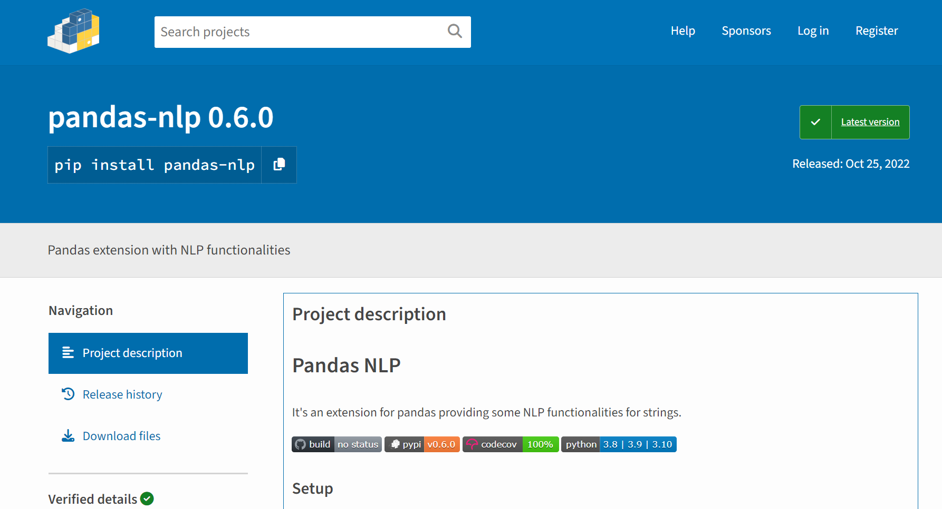
Part2: What I have done with or to those sources?
Part1: What is my source? Why did I choose it?
Topic Analysis (LDA)
High-Frequency Word
Word Segmentation
Word Filtering
Stop-word List
Zhufanzhi Special Dictionary
Panda NLP

Slide 6
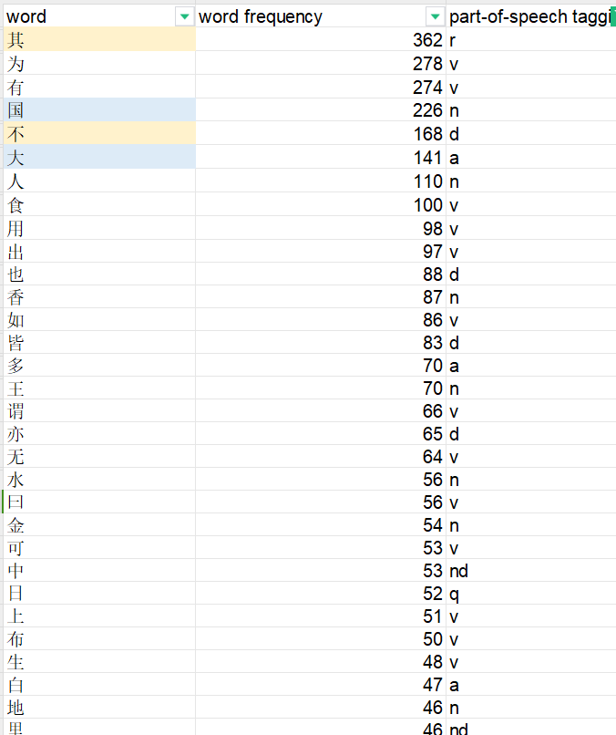
Part2: What I have done with or to those sources?
Part1: What is my source? Why did I choose it?
Topic Analysis (LDA)
High-Frequency Word
Word Segmentation
Word Filtering
Stop-word List
Zhufanzhi Special Dictionary
To be continued...

Slide 7
Part1: What is my source? Why did I choose it?
Part 4: What are my next steps?
Next iteration:
Several Iterations of Word Segementation based on my Stop-word list and Zhufanzhi special dictionary
Word frequency
Topic modeling analysis

Slide 8
Part1: What is my source? Why did I choose it?
Please Give Me Some Feedbacks!

